Slide 1
Interpolation Content
Point data
Interpolation Review
Simple Interpolation
Geostatistical Analyst in ArcGIS
IDW in Geostatistical Analyst
Semivariograms
Auto-correlation Exploration
Kriging

Slide 2
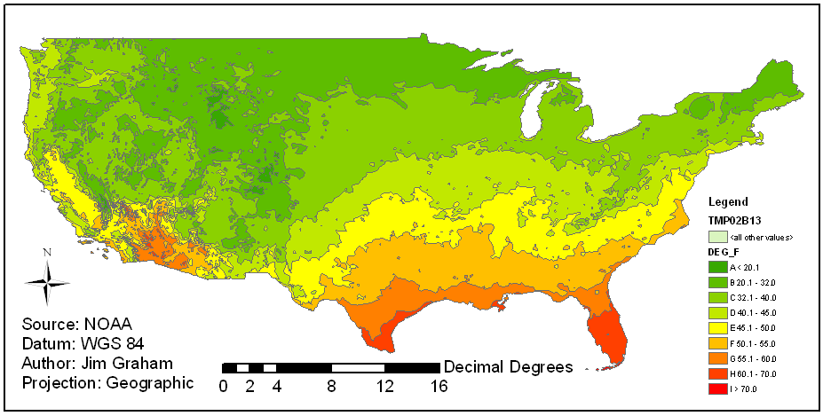
US Temperature Range
Notes:
This is a shapefile of polygons indicating tempature range for the contintental US
The original data is from weather stations scattered across the US
The data was “interpolated” into a raster and then converted to polygons

Slide 3
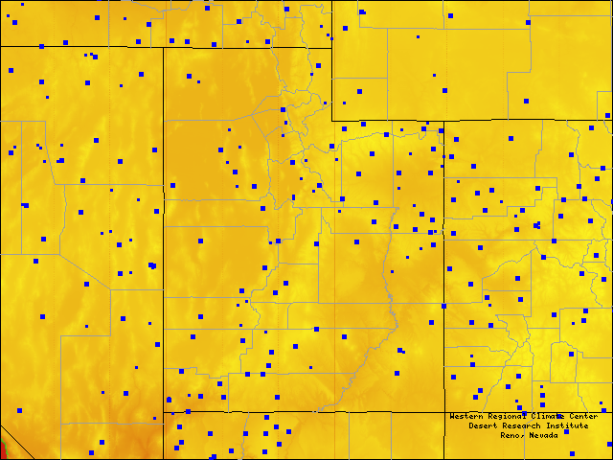
US Weather Stations
~450 km
http://www.raws.dri.edu/

Slide 4

Interpolation
Interpolation is a method of constructing new data points within the range of a discrete set of known data points.
Notes:
This is from species richness data in Rocky Mountain National Park

Slide 5
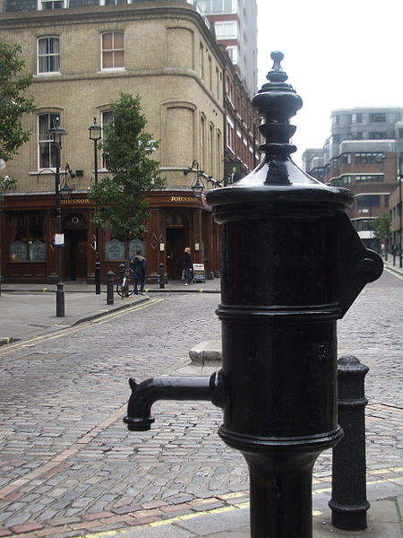
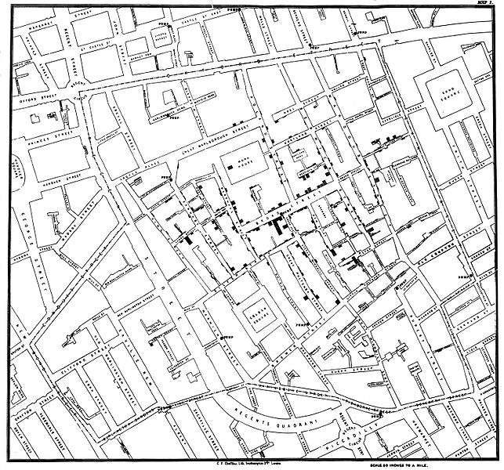
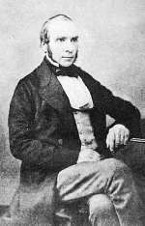
John Snow
Soho, England, 1854
Cholera via polluted water

Slide 6
Simple Interpolation
50
40
35
Measured Values
20
Spatial Cross-section

Slide 7
Linear Interpolation
50
40
35
Measured Values
20
Spatial Cross-section

Slide 8
Linear Interpolation
Trend surface with order of 1
50
40
35
Measured Values
20
55
47
42
36
36
37
38
40
34
28
21
Spatial Cross-section

Slide 9
Process
Obtain points with measurements
Evaluate data (autocorrelation)
Interpolate between the points using:
  Nearest (Natural) Neighbor
  Trend (fitted polynomial)
  Inverse Distance Weighting
  Kriging
  Splines
  Density
Convert the raster to vector using contours

Slide 10
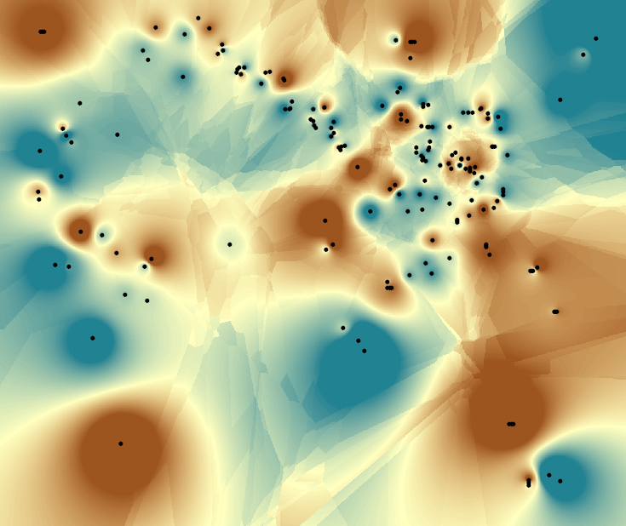
Inverse Distance Weighting
Notes:
- Commonly used where a statistical method is not required

Slide 11
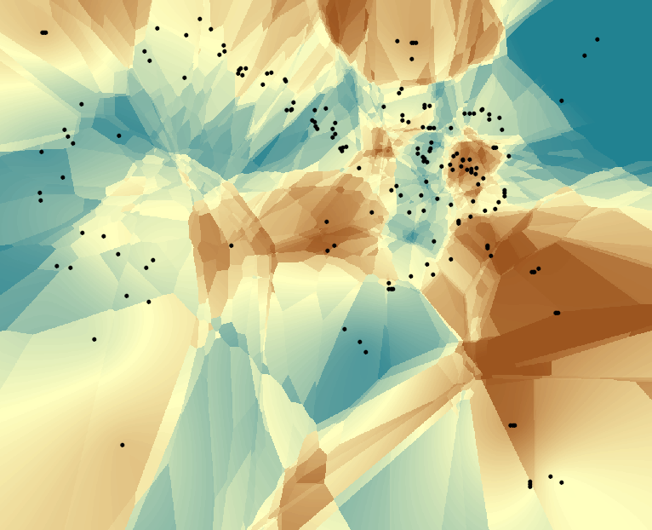
Kriging

Slide 12
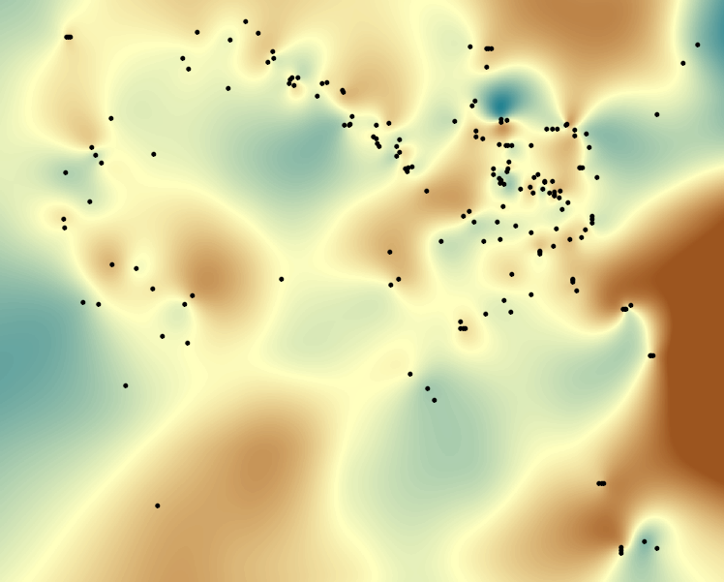
Splines

Slide 13
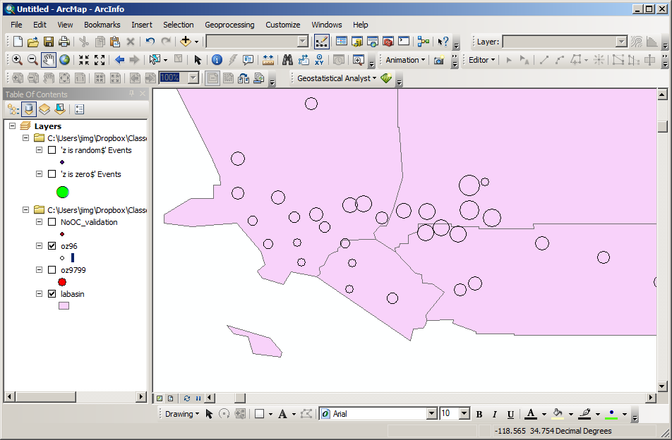
LA Ozone Data

Slide 14
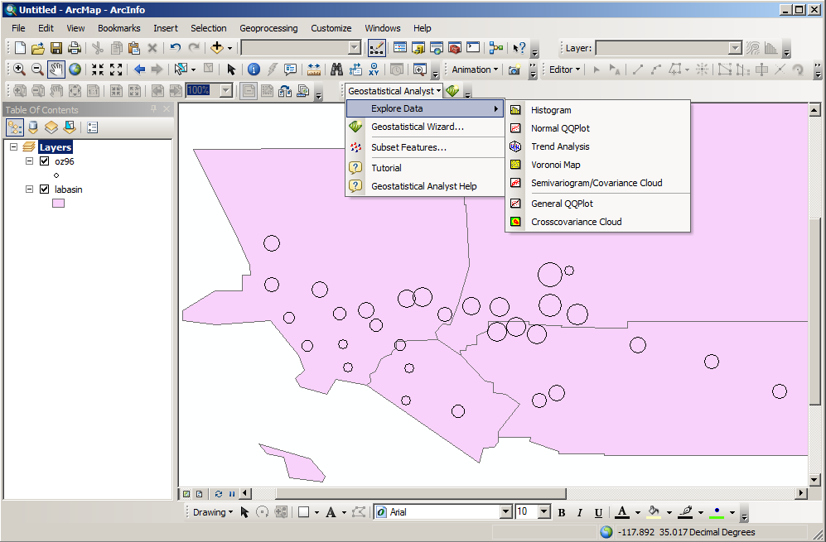
Geostatistical Analyst

Slide 15
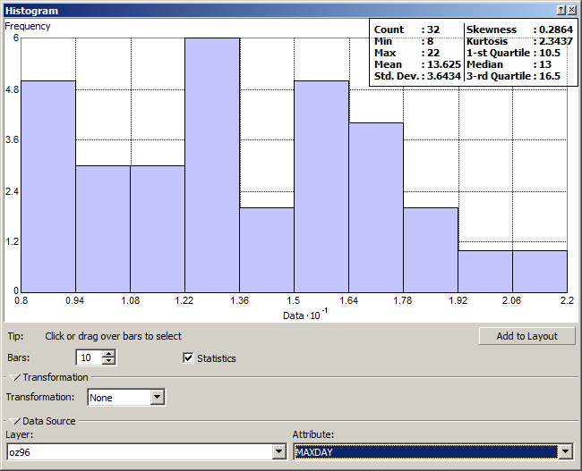
Histograms

Slide 16
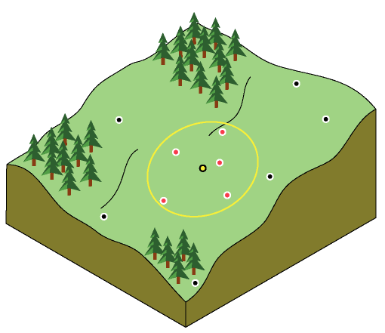
Inverse Distance Weighting
Points closer to the pixel have more “weight”
ArcGIS Help

Slide 17
Inverse Distance Weighting
F_{k}=new value
w_{i}=weight
f_{i}=data value
Square root of distance to point over sum of square root of all distances
General case
“Shepard's Method”
More information: http://en.wikipedia.org/wiki/Inverse_distance_weighting

Slide 18
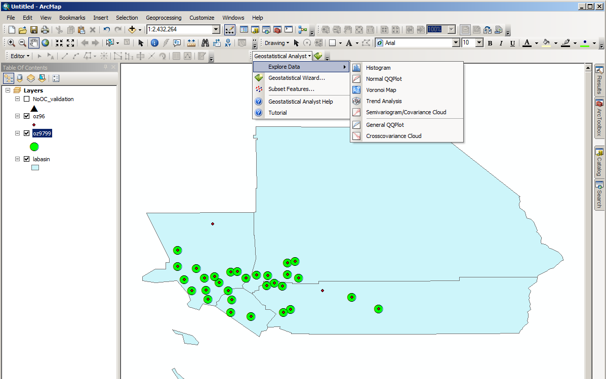
Geostatistical Analyst

Slide 19
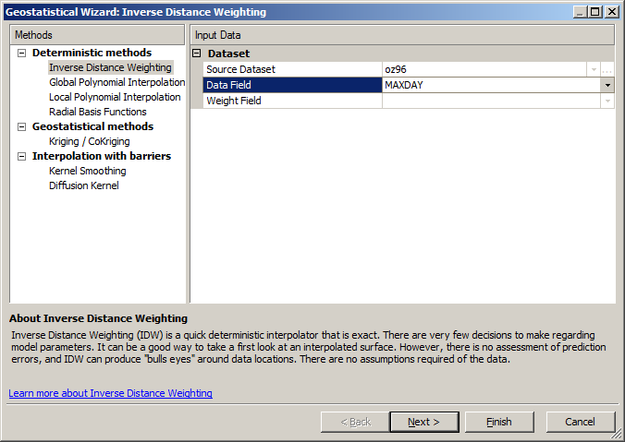
Geostatistical Analyst - IDW

Slide 20
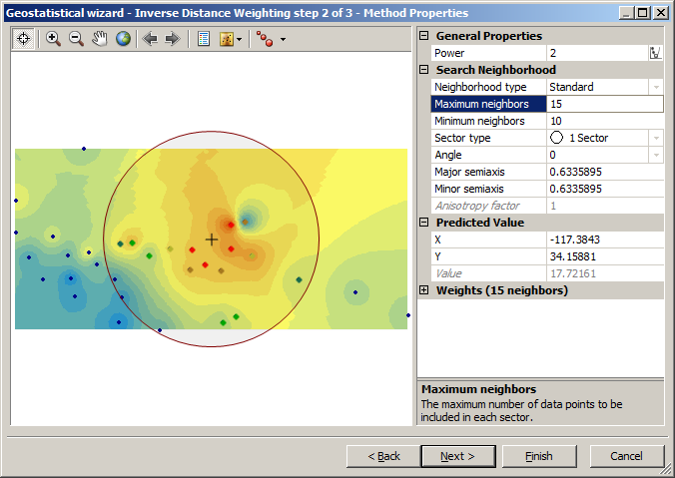
IDW Options

Slide 21
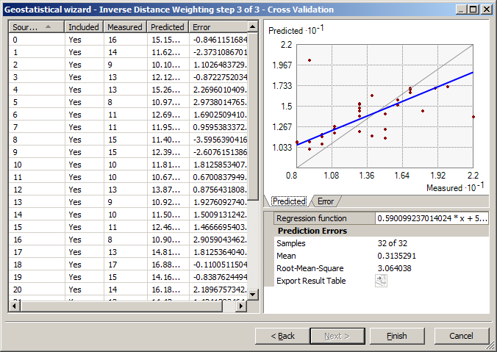
IDW – Cross Validation
Notes:
- Runs IDW without a point and then computes the error between the predicted and data values

Slide 22
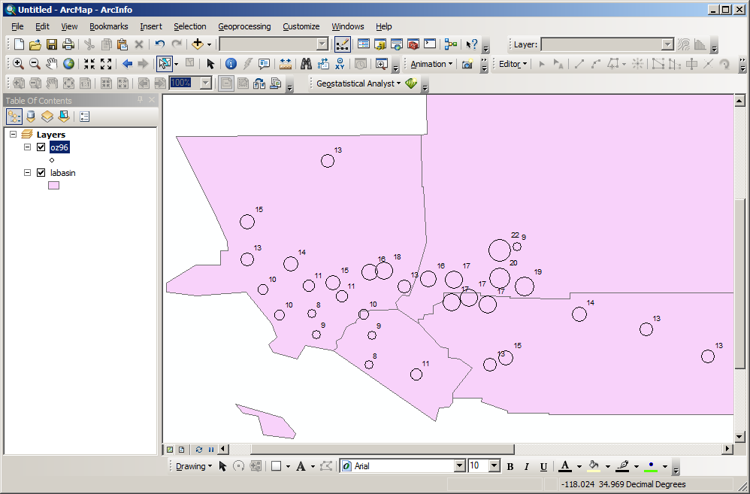
Issue with values 9 and 22

Slide 23
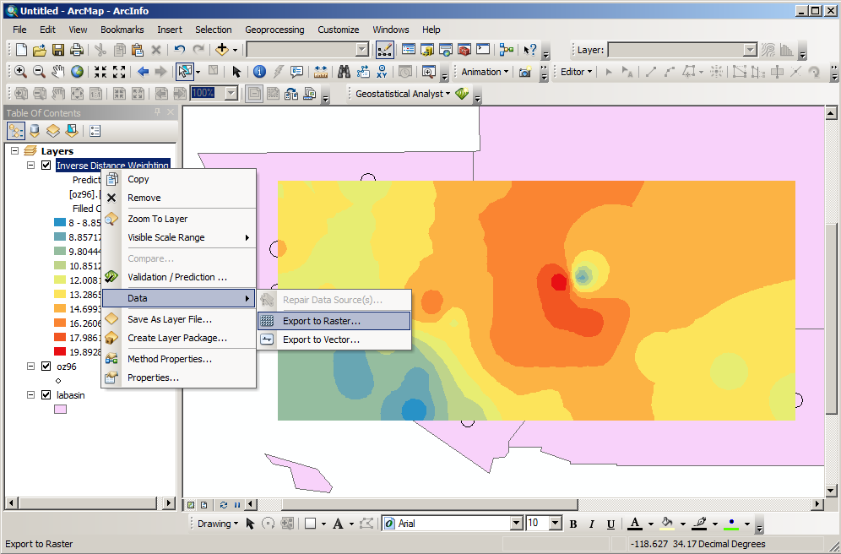
IDW – Posterized Result

Slide 24
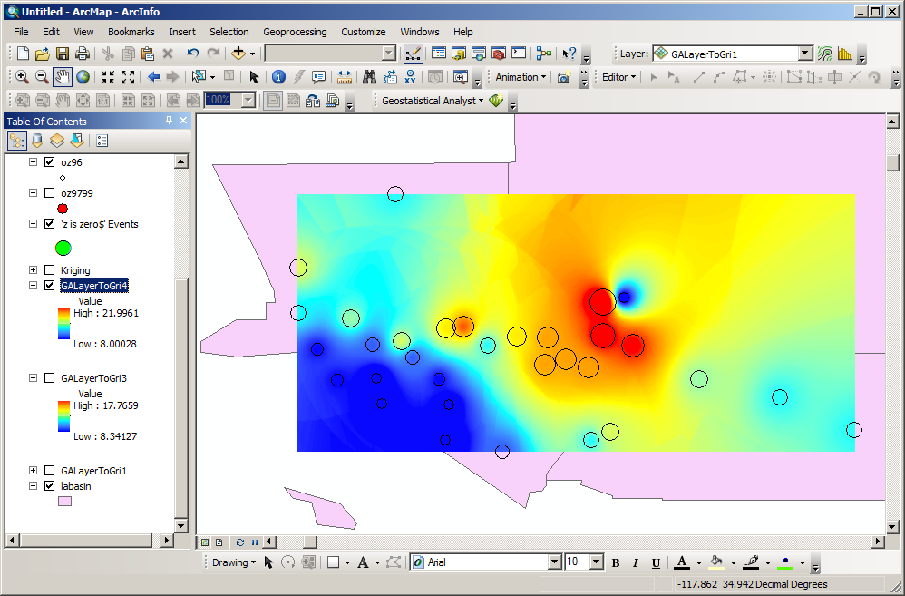
IDW – Continuous Result

Slide 25
Inverse Distance Weighting
No value is outside the available range of values
Assumes 0 uncertainty in the data
Smooth's the data

Slide 26
Kriging
Semivariograms
  Analysis of the nature of autocorrelation
  Determine the parameters for Kriging
Kriging
  Interpolation to raster
  Assumes stochastic data
  Can provide error surface
    Does not include field data error (spatial or measured)

Slide 27
Semivariance
Variance = (z_{i} - z_{j})²
Semivariance = Variance / 2
z_{j}
z_{i} - z_{j}
z_{i}
Point i
Distance
Point j
Notes:
Given two points with the z values of 0 and 2, with distance of 10 between them

Slide 28
Semivariance
For 2 points separated by 10 units with values of 0 and 2:
2
( 0 – 2 )² / 2 = 2
Semivariance
(z_{i} - z_{j})² / 2
Distance Between Points
10
Notes:
Given two points with the z values of 0 and 2, with distance of 10 between them

Slide 29
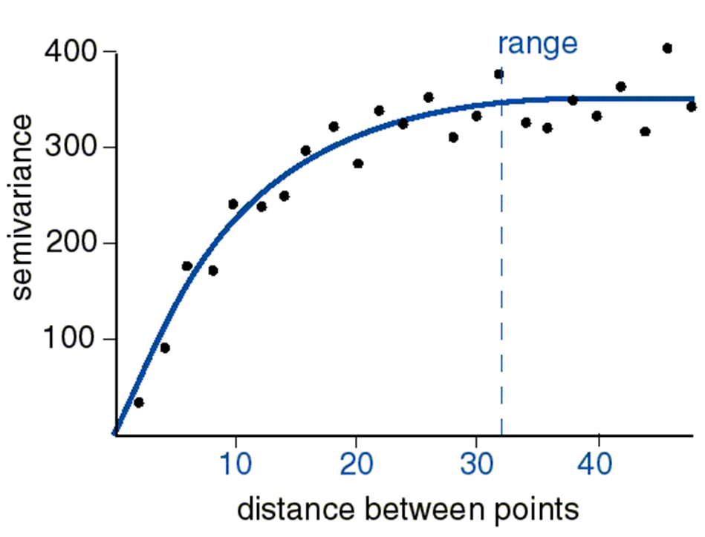
Semivariogram

Slide 30
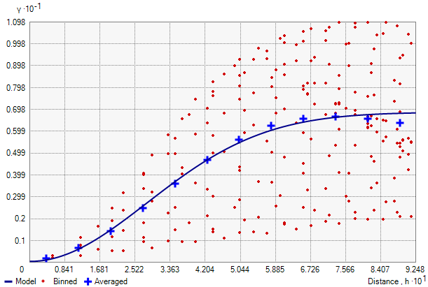
Binned and Averaged

Slide 31
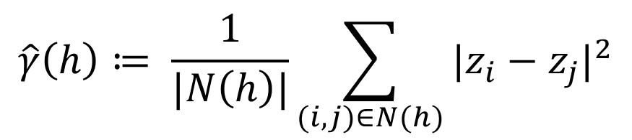
Variogram - Formal Definition
For each pair of points separated by distance h:
  Take the different between the attribute values
  Square it
  Add to sum
Divide the result by the number of pairs

Slide 32
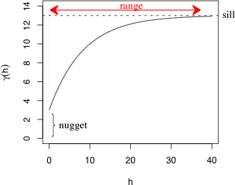
Range, Sill, Nugget
www.unc.edu
Notes:
Nugget – the difference between values when they are coincident. This is also the inherent variation in the values.
Sill – the variance between values after any effect of being close is removed.
Range – the distance for the effect of points being close to one another is removed.

Slide 33
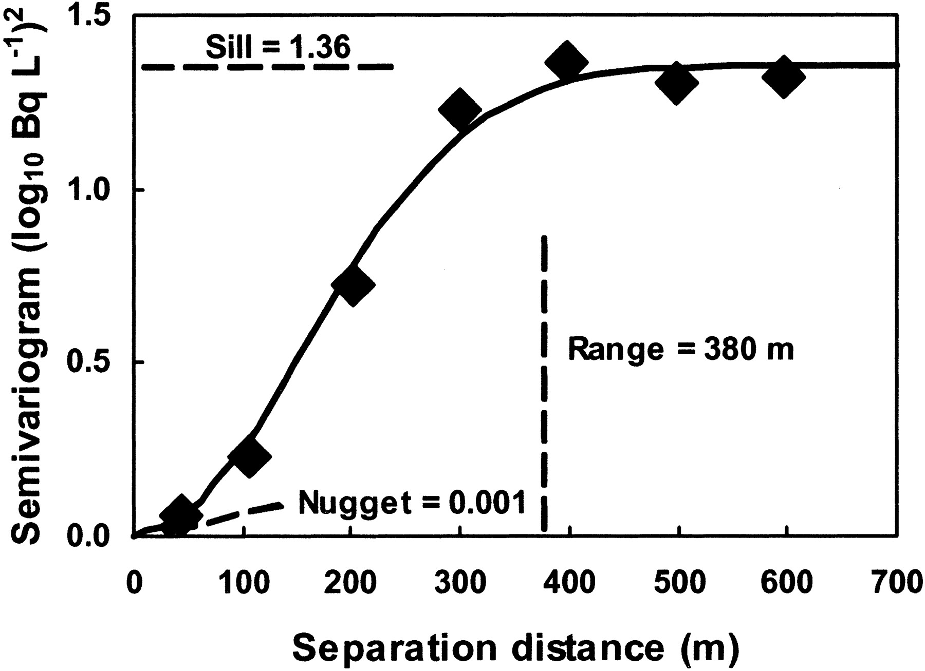
Semivariogram
Andraski, B. J. Plant-Based Plume-Scale Mapping of Tritium Contamination in Desert Soils, vadzone, 2005 4: 819–827
Notes:
- Kriging uses a variogram (function) that describes the variance between values as a function of the distance between them

Slide 34
Synthetic Data Exploration
To evaluate a new tool:
  Create simple datasets in Excel or with a Python
Ask your self:
  How does the tool work?
  What are it’s capabilities?
  What are it’s limitations?

Slide 35

Linear Autocorrelation

Slide 36
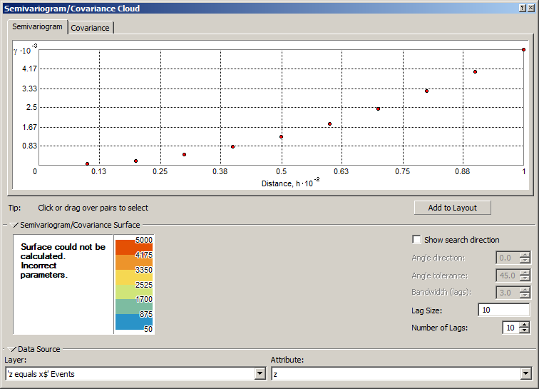
Linear Autocorrelation

Slide 37

Random

Slide 38
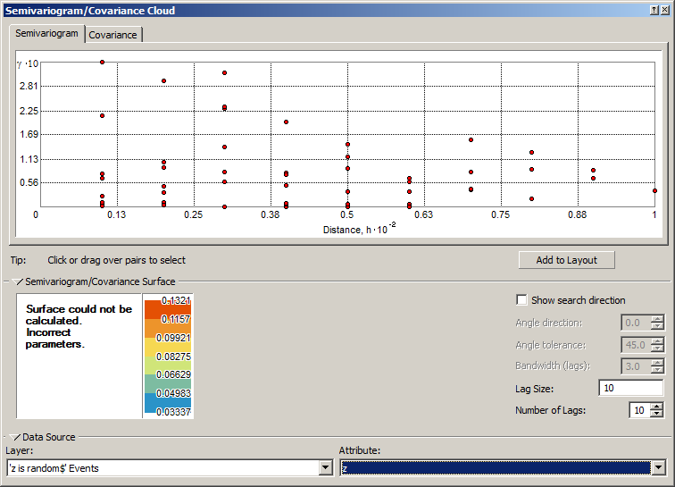
Random

Slide 39

Identical Values

Slide 40
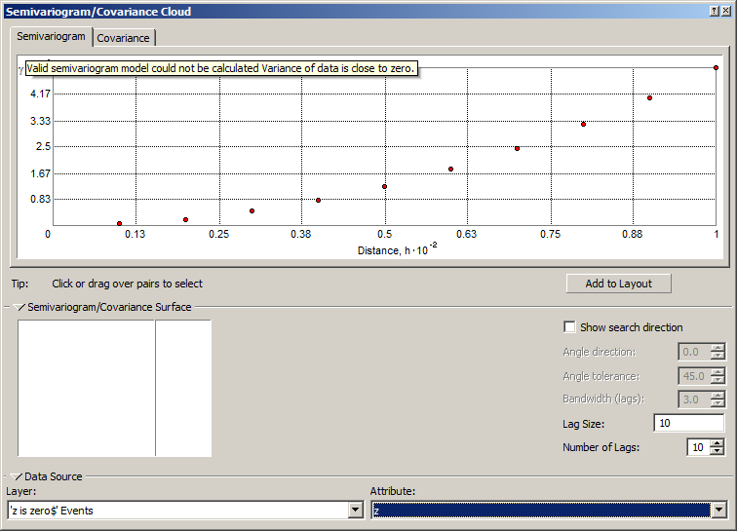
Identical Values

Slide 41
Ozone - Kriging

Slide 42
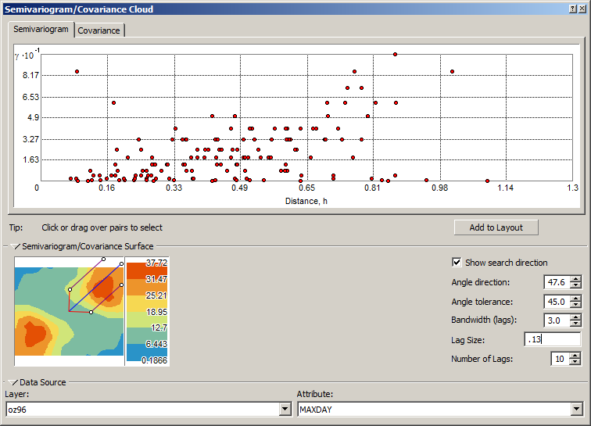
Ozone Semivariogram

Slide 43
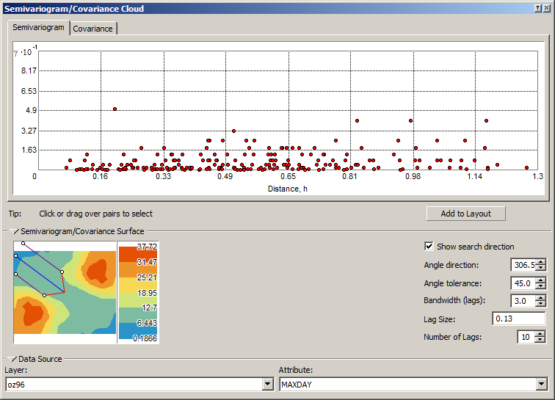
Ozone Semivariogram

Slide 44
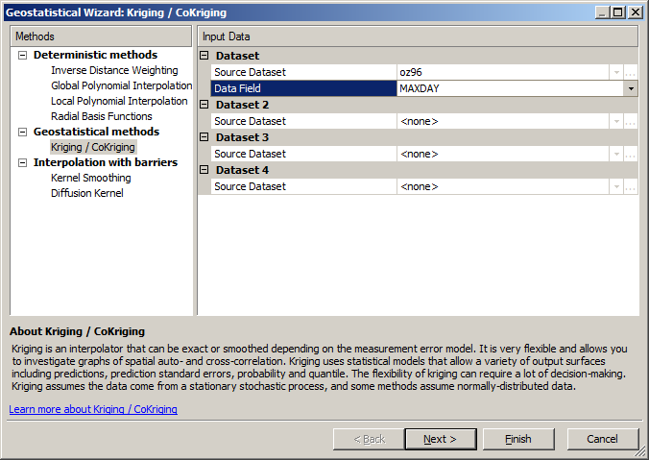
Ordinary Kriging - Example

Slide 45
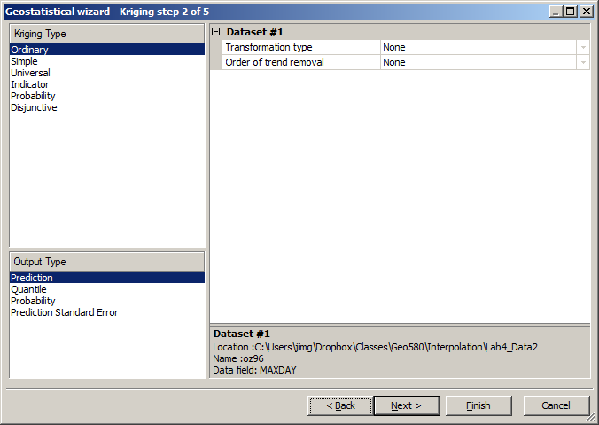
Ordinary Kriging - Example

Slide 46
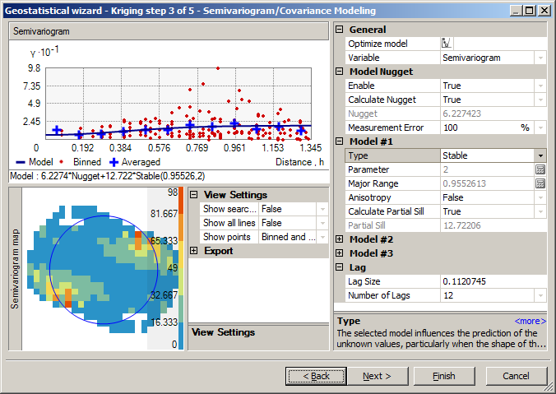
Ordinary Kriging - Example

Slide 47
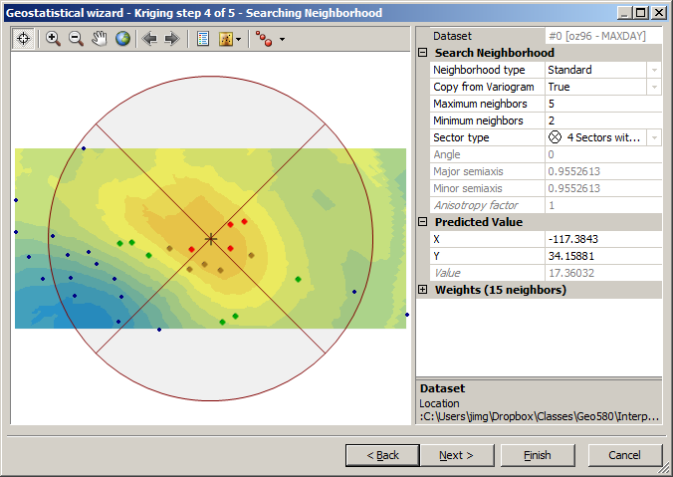
Ordinary Kriging - Example

Slide 48
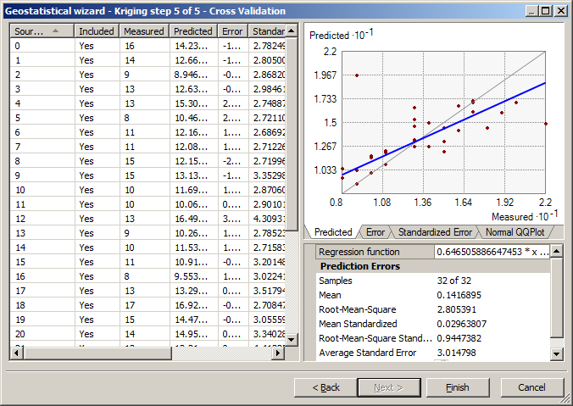
Cross Validation

Slide 49
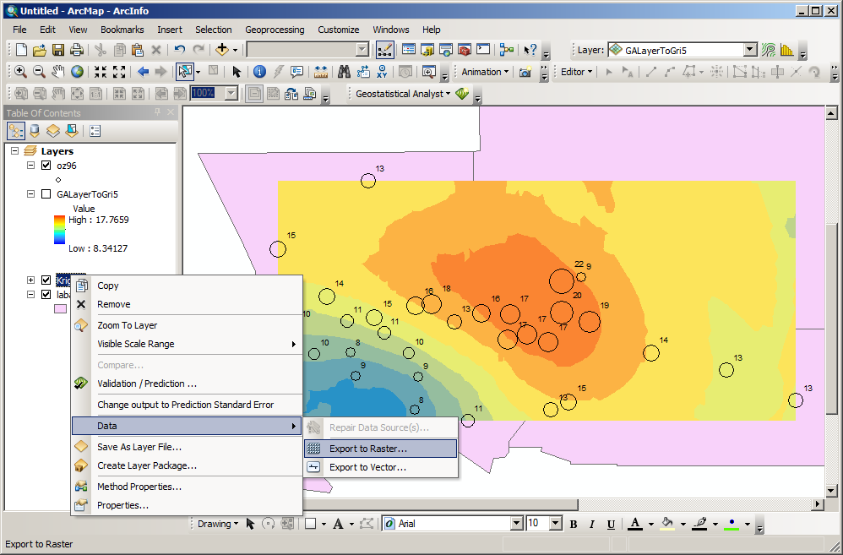
Categorical to Continuous

Slide 50
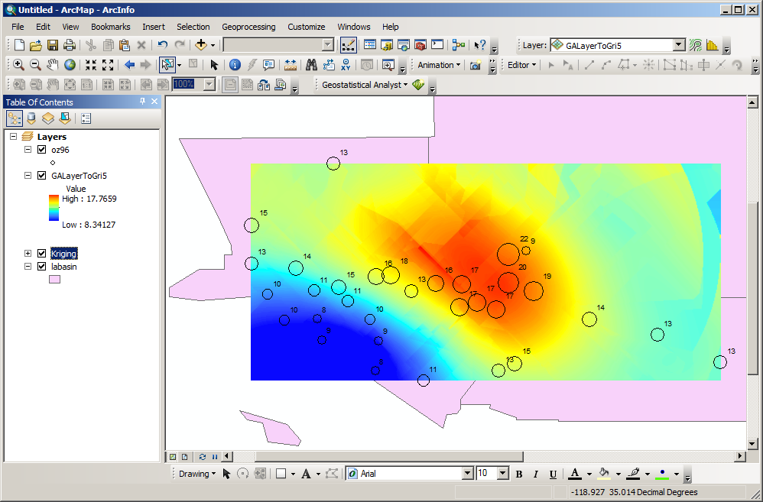
Kriged Surface - Continuous

Slide 51
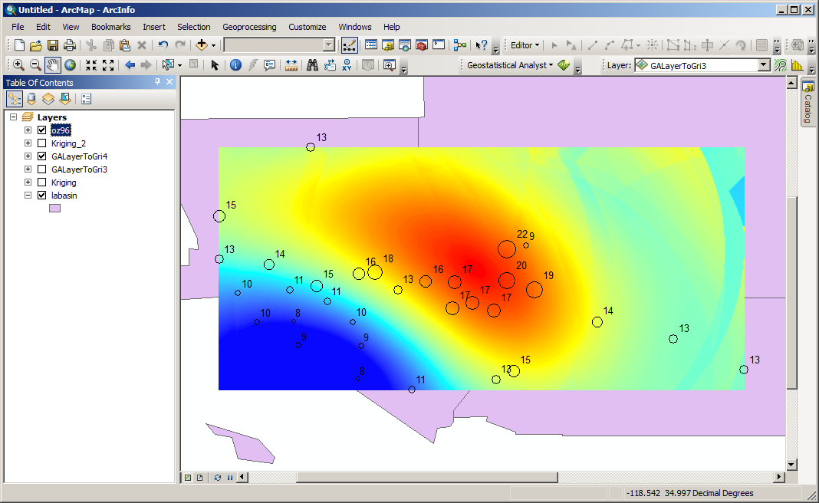
Max Neighbors = 50
Notes:
- Increased the max number of points to 50

Slide 52
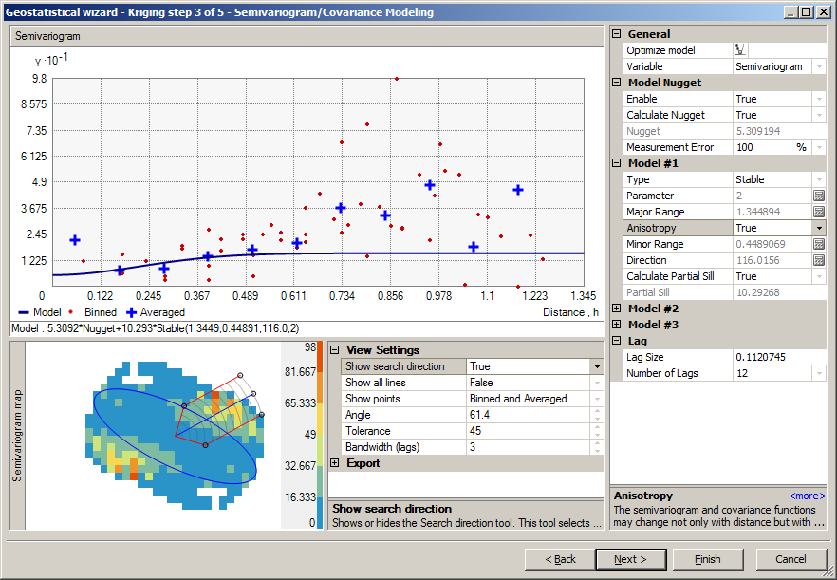
Anisotropic Kriging

Slide 53
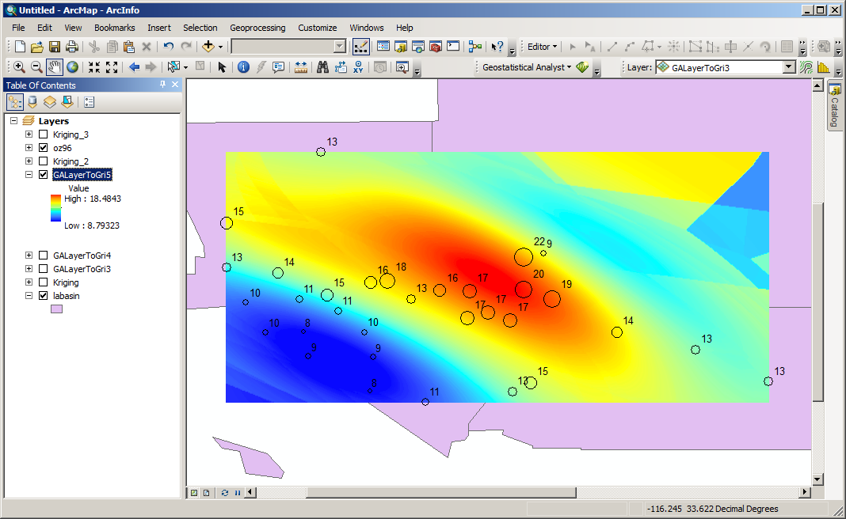
Anisotropic Kriging

Slide 54
IDW – Continuous Result

Slide 55
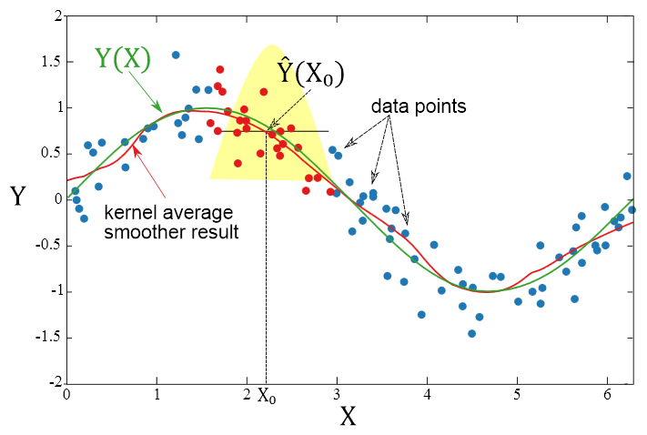
Constant Kernel Smoothing
en.wikipedia.org

Slide 56
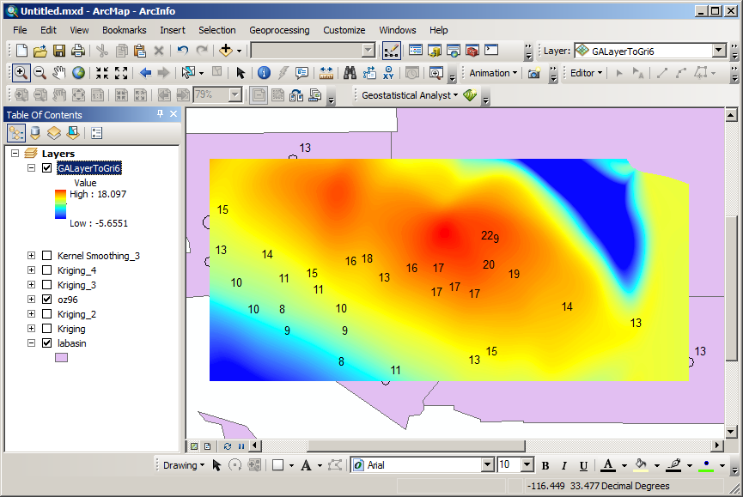
Kernel Smoothing

Slide 57
Interpolation Software
ArcGIS with Geostatistical Analyst
R
Surfer (Golden Software)
Surface II package (Kansas Geological Survey)
GEOEAS (EPA)
Spherekit (NCGIA, UCSB)
Matlab

Slide 58
Cross-Validation
Cross-Validation:
  Comparing a model to a “different” set of date to see if the model is “valid”
Approaches:
  Leave-one-out
  Repeated random: test and training datasets
  K-fold: k equal size subsamples, one for validation
  2-fold (holdout): two datasets of data, one for testing, one for training, then switch

Slide 59
More Resources
Geostatistical Analyst -> Tutorial
Wikipedia:
  http://en.wikipedia.org/wiki/Kriging
USDA geostatistical workshop
  http://www.ars.usda.gov/News/docs.htm?docid=12555
EPA workshop with presentations on geostatistical applications for stream networks:
  http://oregonstate.edu/dept/statistics/epa_program/sac2005js.htm
Notes:
59

Slide 60
Literature
Lam, N.S.-N., Spatial interpolation methods: A review, Am. Cartogr., 10 (2), 129-149, 1983.
Gold, C.M., Surface interpolation, spatial adjacency, and GIS, in Three Dimensional Applications in Geographic Information Systems, edited by J. Raper, pp. 21-35, Taylor and Francis, Ltd., London, 1989.
Robeson, S.M., Spherical methods for spatial interpolation: Review and evaluation, Cartog. Geog. Inf. Sys., 24 (1), 3-20, 1997.
Mulugeta, G., The elusive nature of expertise in spatial interpolation, Cart. Geog. Inf. Sys., 25 (1), 33-41, 1999.
Wang, F., Towards a natural language user interface: An approach of fuzzy query, Int. J. Geog. Inf. Sys., 8 (2), 143-162, 1994.
Davies, C., and D. Medyckyj-Scott, GIS usability: Recommendations based on the user's view, Int. J. Geographical Info. Sys., 8 (2), 175-189, 1994.
Blaser, A.D., M. Sester, and M.J. Egenhofer, Visualization in an early stage of the problem-solving process in GIS, Comp. Geosci, 26, 57-66, 2000.
Notes:
60
Fotheringham A.S., Brunsdon C., and Charlton M. 2000 Quantitative Geography: Perspectives on Spatial Data Analysis. London: Sage.
Fotheringham A.S. and O’Kelly M.E. 1989 Spatial Interaction Models: Formulations and Applications. Dordrecht: Kluwer.

